Slide 1
Fast Computation of Database Operations using Graphics Processors
Naga K. Govindaraju Univ. of North Carolina

Slide 2
Goal
Utilize graphics processors for fast computation of common database operations

Slide 3
Motivation: Fast operations
Increasing database sizes
Faster processor speeds but low improvement in query execution time
  Memory stalls
  Branch mispredictions
  Resource stalls Eg. Instruction dependency
Notes:
One of the main reasons for requiring fast database operations is the increase in database sizes leading to an increase in query execution time. On the other hand, improvements in semi-conductor technology lead to faster processor speeds. However, there is relatively low
Improvement in query execution time as traditional database operation implementations involve memory stalls due to cache misses, branch mispredictions due to conditionals, resource stalls due to instruction dependencies etc. Therefore, there is a need to develop new algorithms that take advantage of the architecture features and reduce query execution times

Slide 4
Graphics Processors
Present in most PCs
Designed primarily for fast rendering – games
High growth rate

Slide 5
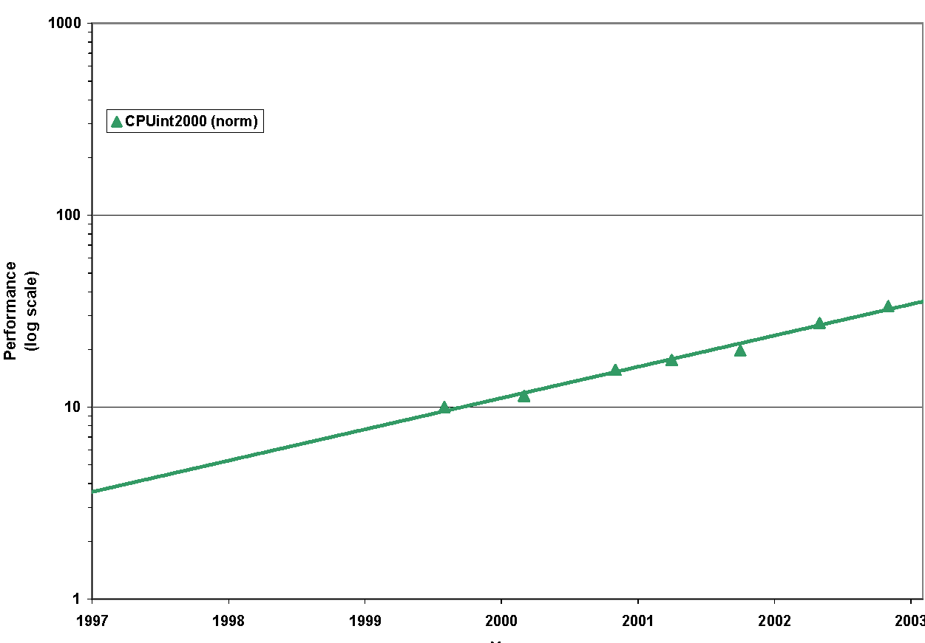
CPU
Notes:
Now let us analyze the performance of current GPU performance growth rate and Bandwidth growth rate
Current GPUs can render hundreds of millions of triangles and exhibit high performance capabilities
This graph indicates that the GPU growth rate is faster than Moore’s law. In other words, algorithms that
Are rendering based scale at a rate faster than Moore’s law.
Now let us look at the Bandwidth growth rate.
The graph indicates that the Bandwidth growth rate is much lower than Moore’s law. In other words, algorithms that
Perform framebuffer readbacks scale at a rate less than Moore’s law

Slide 6
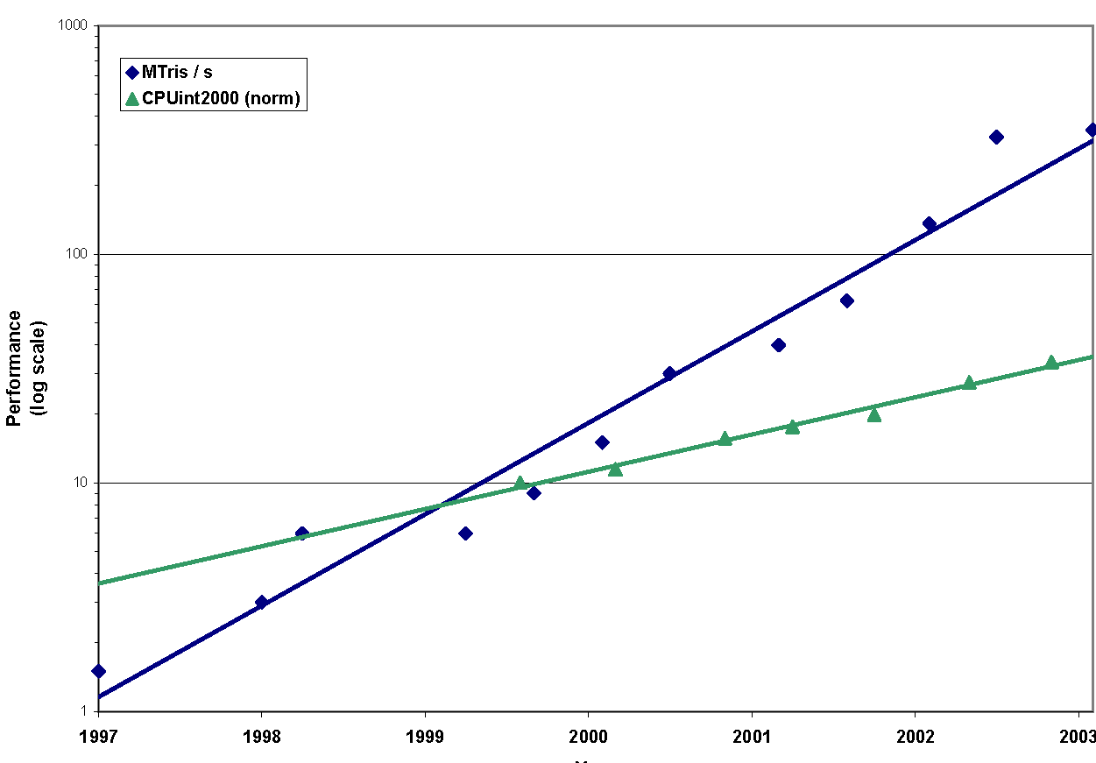
GPU
CPU

Slide 7
Graphics Processors
Large computational power
  Simple but efficient pipeline design
  Multiple processing units
Programmable
Vector Processors

Slide 8
Graphics Processors
Low bandwidth to CPU

Slide 9
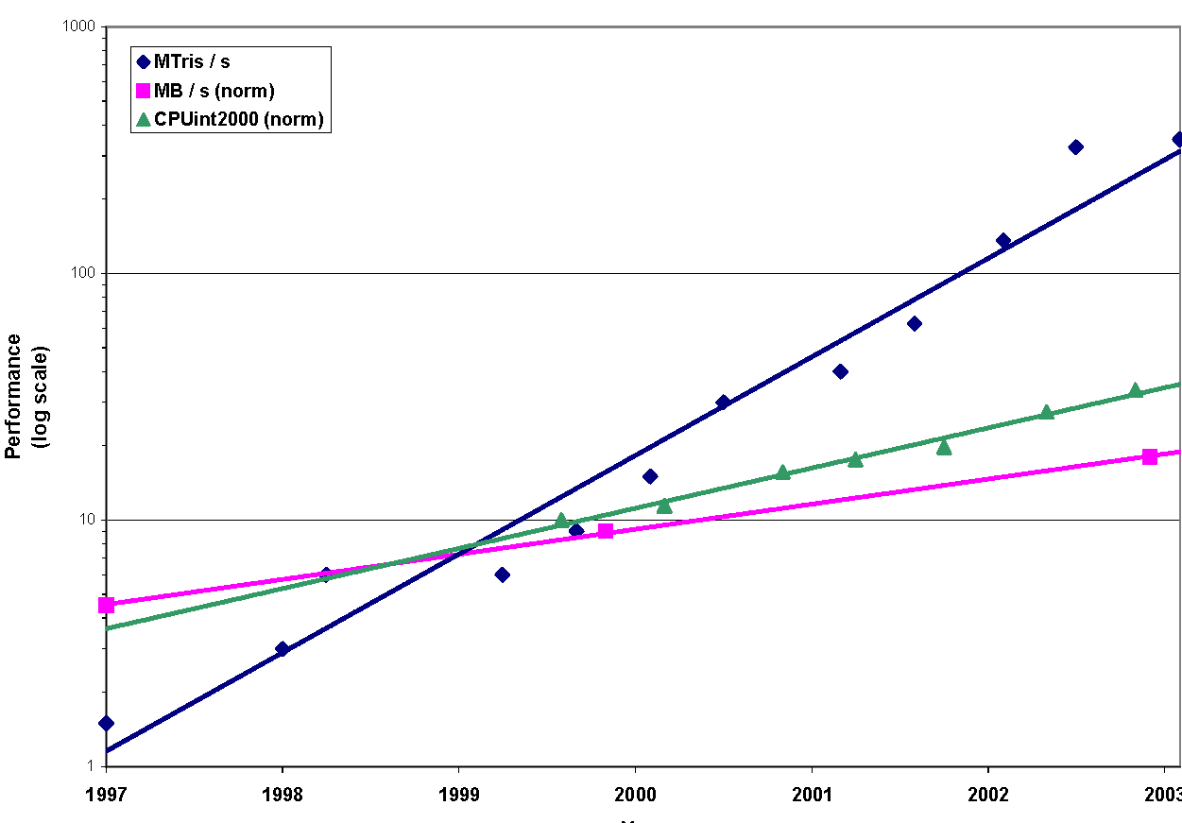
GPU
CPU
Bandwidth

Slide 10
Graphics Processors:
Design Issues
Design database operations avoiding frame buffer readbacks
No arbitrary writes
  Design algorithms avoiding data rearrangements
Programmable pipeline has poor branching
  Design algorithms without branching in programmable pipeline - evaluate branches using fixed function tests

Slide 11
Related Work
Hardware Acceleration for DB operations
  Vector processors for relational DB operations
  [Meki and Kambayashi 2000]
  SIMD instructions for relational DB operations
  [ Zhou and Ross 2002]
  GPUs for spatial selections and joins [Sun et al. 2003]
General purpose computing using GPUs
  Presented in rest of course.

Slide 12
Outline
Database Operations on GPUs
Implementation & Results
Analysis
Conclusions

Slide 13
Outline
Database Operations on GPUs
Implementation & Results
Analysis
Conclusions

Slide 14
Overview
Database operations require comparisons
Utilize depth test functionality of GPUs for performing comparisons
  Implements all possible comparisons <, <=, >=, >, ==, !=, ALWAYS, NEVER
Utilize stencil test for data validation and storing results of comparison operations

Slide 15
Basic Operations
Basic SQL query
        Select A
        From T
        Where C
A= attributes or aggregations (SUM, COUNT, MAX etc)
T=relational table
C= Boolean Combination of Predicates (using operators AND, OR, NOT)

Slide 16
Outline: Database Operations
Predicate Evaluation
Boolean Combinations of Predicates
Aggregations

Slide 17
Outline: Database Operations
Predicate Evaluation
Boolean Combinations of Predicates
Aggregations

Slide 18
Basic Operations
Predicates – a_{i} op constant or
a_{i} op a_{j}
  Op is one of <,>,<=,>=,!=, =, TRUE, FALSE
Boolean combinations – Conjunctive Normal Form (CNF) expression evaluation
Aggregations – COUNT, SUM, MAX, MEDIAN, AVG

Slide 19
Predicate Evaluation
a_{i} op constant (d)
  Copy the attribute values a_{i} into depth buffer
  Define the comparison operation using depth test
  Draw a screen filling quad at depth d

Slide 20
a_{i} op d
If ( a_{i} op d )
pass fragment
Else
reject fragment
P
Screen
d

Slide 21
Predicate Evaluation
a_{i} op a_{j}
  Treat as (a_{i} – a_{j}) op 0
Semi-linear queries
  Defined as linear combination of attribute values compared against a constant
  Linear combination is computed as a dot product of two vectors
  Utilize the vector processing capabilities of GPUs

Slide 22
Data Validation
Performed using stencil test
Valid stencil values are set to a given value “s”
Data values that fail predicate evaluation are set to “zero”

Slide 23
Outline: Database Operations
Predicate Evaluation
Boolean Combinations of Predicates
Aggregations

Slide 24
Boolean Combinations
Expression provided as a CNF
CNF is of form
(A₁ AND A₂ AND … AND A_{k})
where A_{i} = (B^{i}₁ OR B^{i}₂ OR … OR B^{i}_{mi} )
CNF does not have NOT operator
  If CNF has a NOT operator, invert comparison operation to eliminate NOT
  Eg. NOT (a_{i} < d) => (a_{i} >= d)

Slide 25
Boolean Combination
We will focus on (A₁ AND A₂)
All cases are considered
  A₁ = (TRUE AND A₁)
  If E_{i} = (A₁ AND A₂ AND … AND A_{i-1} AND A_{i}),
  E_{i} = (E_{i-1} AND A_{i})

Slide 26
A₁ AND A₂
A₁
B²₃
B²₂
B²₁

Slide 27
A₁ AND A₂
Stencil value = 1
A₁

Slide 28
A₁ AND A₂
Stencil value = 0
A₁
Stencil value = 1

Slide 29
A₁ AND A₂
Stencil = 0
A₁
B²₂
Stencil=2
Stencil = 1
B²₃
Stencil=2
B²₁
Stencil=2

Slide 30
A₁ AND A₂
Stencil = 0
A₁
B²₂
Stencil=2
Stencil = 1
B²₃
Stencil=2
B²₁
Stencil=2

Slide 31
A₁ AND A₂
Stencil = 2
A₁ AND B²₂
Stencil = 0
Stencil=2
A₁ AND B²₃
Stencil=2
A₁ AND B²₁

Slide 32
Range Query
Compute a_{i} within [low, high]
  Evaluated as ( a_{i} >= low ) AND ( a_{i} <= high )

Slide 33
Outline: Database Operations
Predicate Evaluation
Boolean Combinations of Predicates
Aggregations

Slide 34
Aggregations
COUNT, MAX, MIN, SUM, AVG
No data rearrangements

Slide 35
COUNT
Use occlusion queries to get pixel pass count
Syntax:
  Begin occlusion query
  Perform database operation
  End occlusion query
  Get count of number of attributes that passed database operation
Involves no additional overhead!

Slide 36
MAX, MIN, MEDIAN
We compute Kth-largest number
Traditional algorithms require data rearrangements
We perform no data rearrangements, no frame buffer readbacks

Slide 37
K-th Largest Number
Say v_{k} is the k-th largest number
How do we generate a number m equal to v_{k}?
  Without knowing v_{k}’s bit-representation and using comparisons

Slide 38
Our algorithm
Initialize m to 0
Start with the MSB and scan all bits till LSB
At each bit, put 1 in the corresponding bit-position of m
If m>v_{k}, make that bit 0
Proceed to the next bit

Slide 39
Example
V_{k} = 11101001
M = 00000000

Slide 40
Example
V_{k} = 11101001
M = 10000000
M <= V_{k}

Slide 41
Example
V_{k} = 11101001
M = 11000000
M <= V_{k}

Slide 42
Example
V_{k} = 11101001
M = 11100000
M <= V_{k}

Slide 43
Example
V_{k} = 11101001
M = 11110000
M > V_{k}
Make the bit 0
M = 11100000

Slide 44
Example
V_{k} = 11101001
M = 11101000
M <= V_{k}

Slide 45
Example
V_{k} = 11101001
M = 11101100
M > V_{k}
Make this bit 0
M = 11101000

Slide 46
Example
V_{k} = 11101001
M = 11101010
M > V_{k}
M = 11101000

Slide 47
Example
V_{k} = 11101001
M = 11101001
M <= V_{k}

Slide 48
K-th Largest Number
Lemma: Let v_{k} be the k-th largest number. Let count be the number of values >= m
  If count > (k-1): m<= v_{k}
  If count <= (k-1): m>v_{k}
Apply the earlier algorithm ensuring that count >(k-1)

Slide 49
Example
Integers ranging from 0 to 255
Represent them in depth buffer
  Idea – Use depth functions to perform comparisons
  Use NV_occlusion_query to determine maximum

Slide 50
Example: Parallel Max
S={10,24,37,99,192,200,200,232}
Step 1: Draw Quad at 128
  S = {10,24,37,99,192,200,200,232}
Step 2: Draw Quad at 192
  S = {10,24,37,192,200,200,232}
Step 3: Draw Quad at 224
  S = {10,24,37,192,200,200,232}
Step 4: Draw Quad at 240 – No values pass
Step 5: Draw Quad at 232
  S = {10,24,37,192,200,200,232}
Step 6,7,8: Draw Quads at 236,234,233 – No values pass
Max is 232

Slide 51
Parallel Max
Use occlusion queries to determine the next stepping value
  No frame buffer readbacks

Slide 52
Accumulator, Mean
Accumulator - Use sorting algorithm and add all the values
Mean – Use accumulator and divide by n
Interval range arithmetic
Alternative algorithm
  Use fragment programs – requires very few renderings
  Use mipmaps [Harris et al. 02], fragment programs [Coombe et al. 03]

Slide 53
Accumulator
Data representation is of form
  a_{k} 2^{k} + a_{k-1} 2^{k-1} + … + a₀
  Sum = sum(a_{k}) 2^{k}+ sum(a_{k-1}) 2^{k-1}+…+sum(a₀)
  Current GPUs support no bit-masking operations

Slide 54
TestBit
Read the data value from texture, say a_{i}
F= frac(a_{i}/2^{k})
If F>=0.5, then k-th bit of a_{i} is 1
Set F to alpha value. Alpha test passes a fragment if alpha value>=0.5

Slide 55
Outline
Database Operations on GPUs
Implementation & Results
Analysis
Conclusions

Slide 56
Implementation
Dell Precision Workstation with Dual 2.8GHz Xeon Processor
NVIDIA GeForce FX 5900 Ultra GPU
2GB RAM

Slide 57
Implementation
CPU – Intel compiler 7.1 with hyperthreading, multi-threading, SIMD optimizations
GPU – NVIDIA Cg Compiler

Slide 58
Benchmarks
TCP/IP database with 1 million records and four attributes
Census database with 360K records

Slide 59
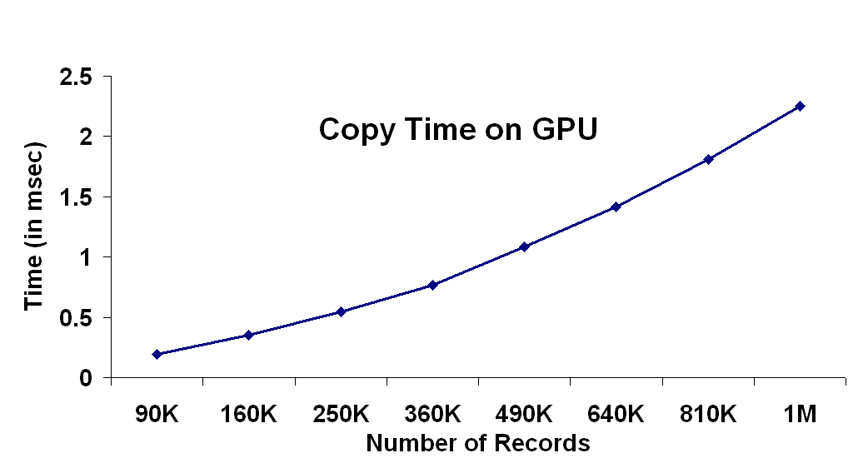
Copy Time

Slide 60
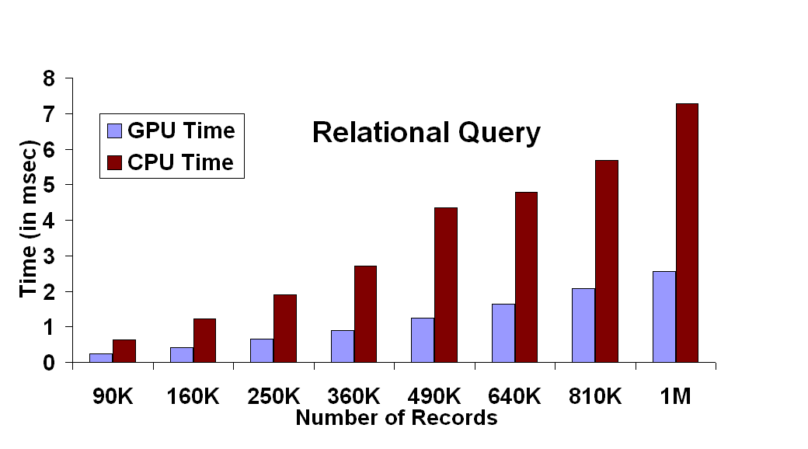
Predicate Evaluation

Slide 61
Range Query

Slide 62
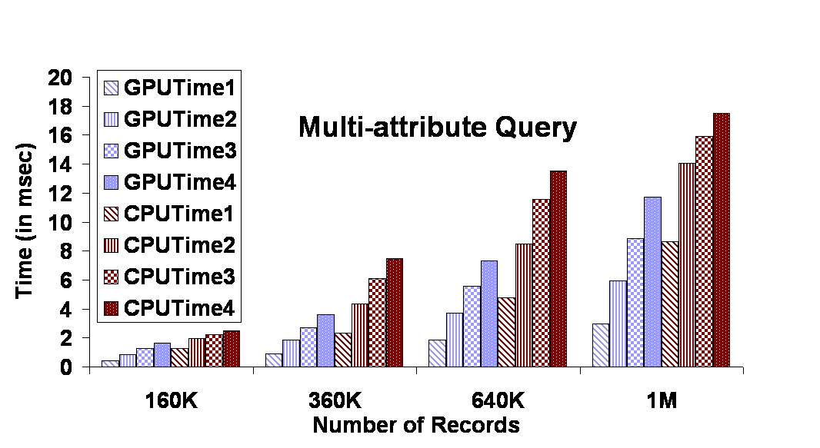
Multi-Attribute Query

Slide 63
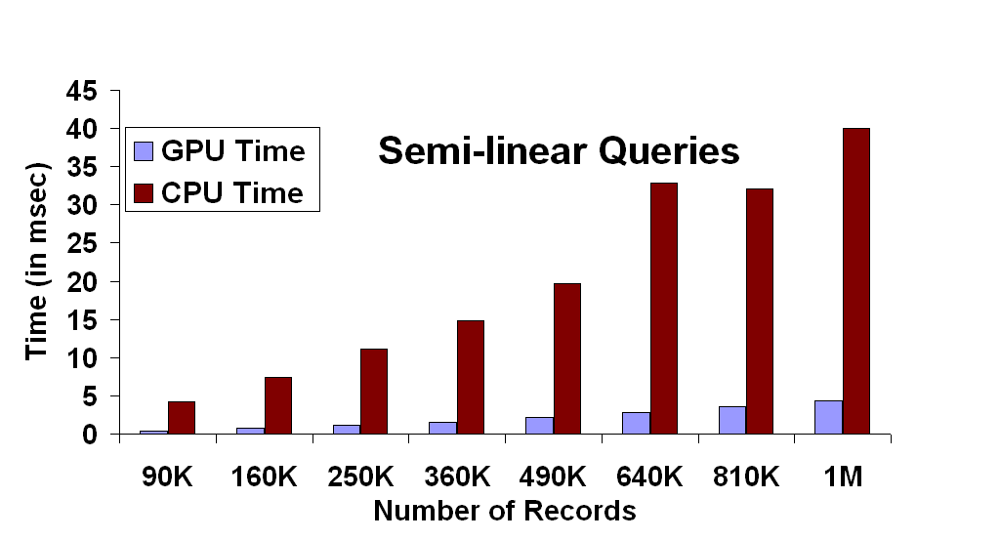
Semi-linear Query

Slide 64
COUNT
Same timings for GPU implementation

Slide 65
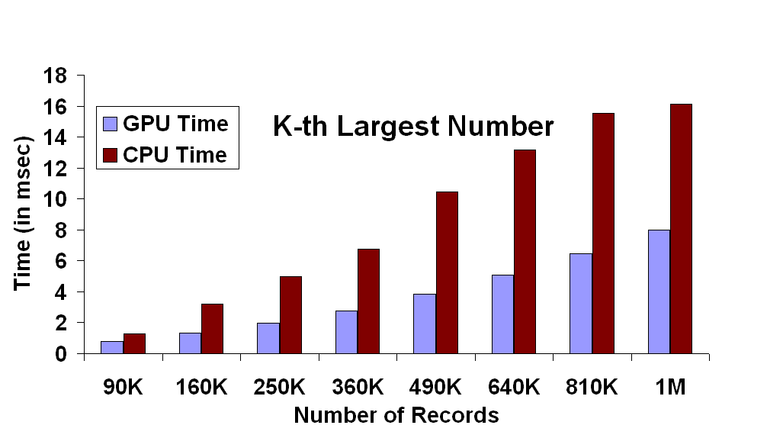
Kth-Largest

Slide 66
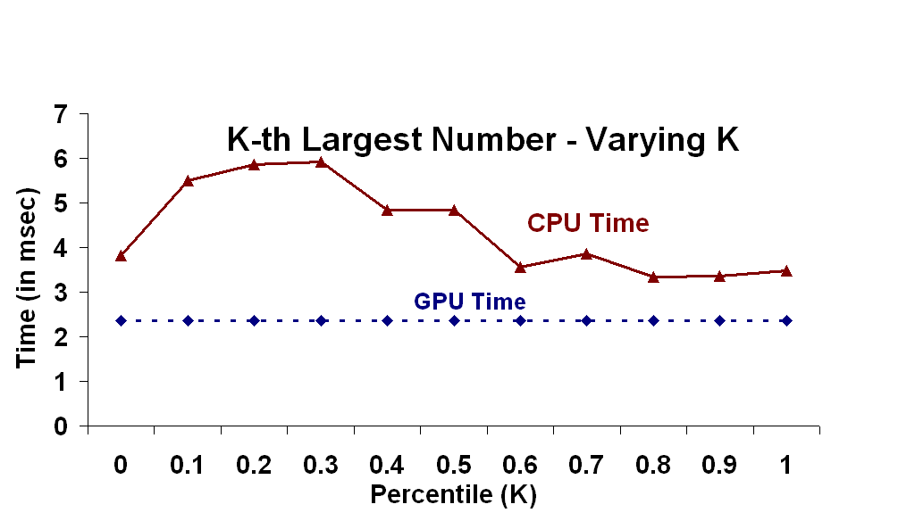
Kth-Largest

Slide 67
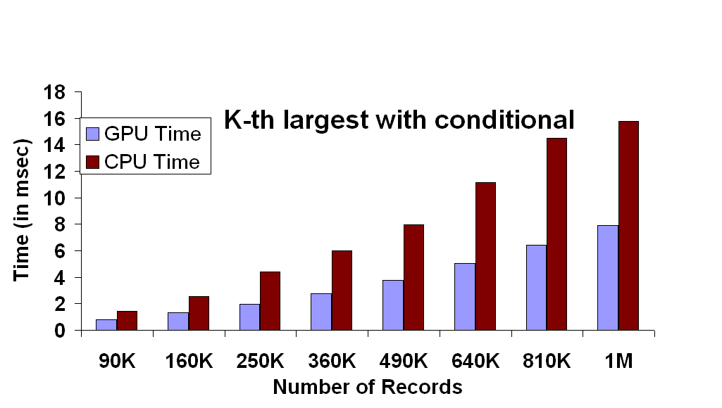
Kth-Largest conditional

Slide 68
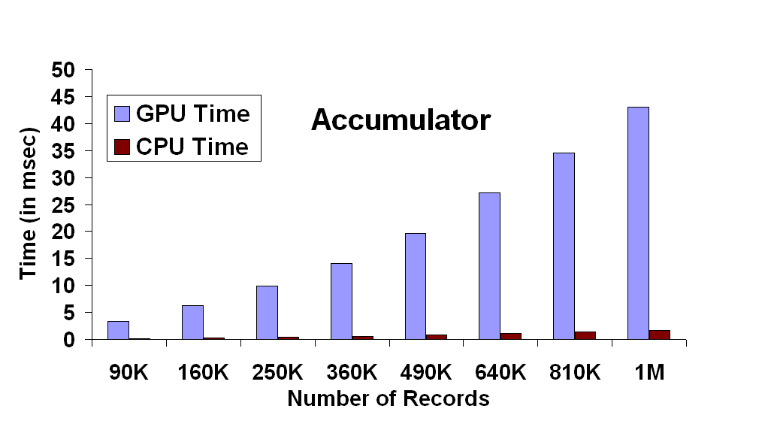
Accumulator

Slide 69
Outline
Database Operations on GPUs
Implementation & Results
Analysis
Conclusions

Slide 70
Analysis: Issues
Precision
Copy time
Integer arithmetic
Depth compare masking
Memory management
No Branching
No random writes

Slide 71
Analysis: Performance
Relative Performance Gain
  High Performance – Predicate evaluation, multi-attribute queries, semi-linear queries, count
  Medium Performance – Kth-largest number
  Low Performance - Accumulator

Slide 72
High Performance
Parallel pixel processing engines
Pipelining
Early Z-cull
Eliminate branch mispredictions

Slide 73
Medium Performance
Parallelism
FX 5900 has clock speed 450MHz, 8 pixel processing engines
Rendering single 1000x1000 quad takes 0.278ms
Rendering 19 such quads take 5.28ms. Observed time is 6.6ms
80% efficiency in parallelism!!

Slide 74
Low Performance
No gain over SIMD based CPU implementation
Two main reasons:
  Lack of integer-arithmetic
  Clock rate

Slide 75
Advantages
Algorithms progress at GPU growth rate
Offload CPU work
Fast due to massive parallelism on GPUs
Algorithms could be generalized to any geometric shape
  Eg. Max value within a triangular region

Slide 76
Advantages
Commodity hardware!

Slide 77
Outline
Database Operations on GPUs
Implementation & Results
Analysis
Conclusions

Slide 78
Conclusions
Novel algorithms to perform database operations on GPUs
  Evaluation of predicates, boolean combinations of predicates, aggregations
Algorithms take into account GPU limitations
  No data rearrangements
  No frame buffer readbacks

Slide 79
Conclusions
Preliminary comparisons with optimized CPU implementations is promising
Discussed possible improvements on GPUs
GPU as a useful co-processor

Slide 80
Future Work
Improve performance of many of our algorithms
More database operations such as join, sorting, classification and clustering.
Queries on spatial and temporal databases

Slide 81
Acknowledgements
Army Research Office
National Science Foundation
Office of Naval Research
Intel Corporation
NVIDIA Corporation
Jasleen Sahni, UNC
UNC GAMMA Group

